Slide 1
INFORMATICA POWERCENTER
Nikita Kulkarni
Pan Chen

Slide 2
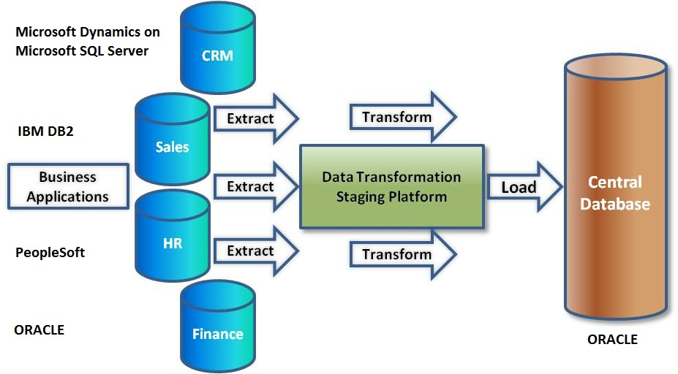
What is ETL?
■ Informatica PowerCenter is an ETL tool
■ ETL stands for Extract, Transform and Load data from different heterogeneous data sources to commonly one data source.
■ This Process is called Data Integration

Slide 3
Data Integration
Organization now trying to make themselves much more operational with easy-to-interoperate data.
Data is most important part of any organization.
Data is backbone of any report and reports are the baseline on which all the vital management decisions are taken.
Data coexist in different maybe heterogeneous data sources.

Slide 4
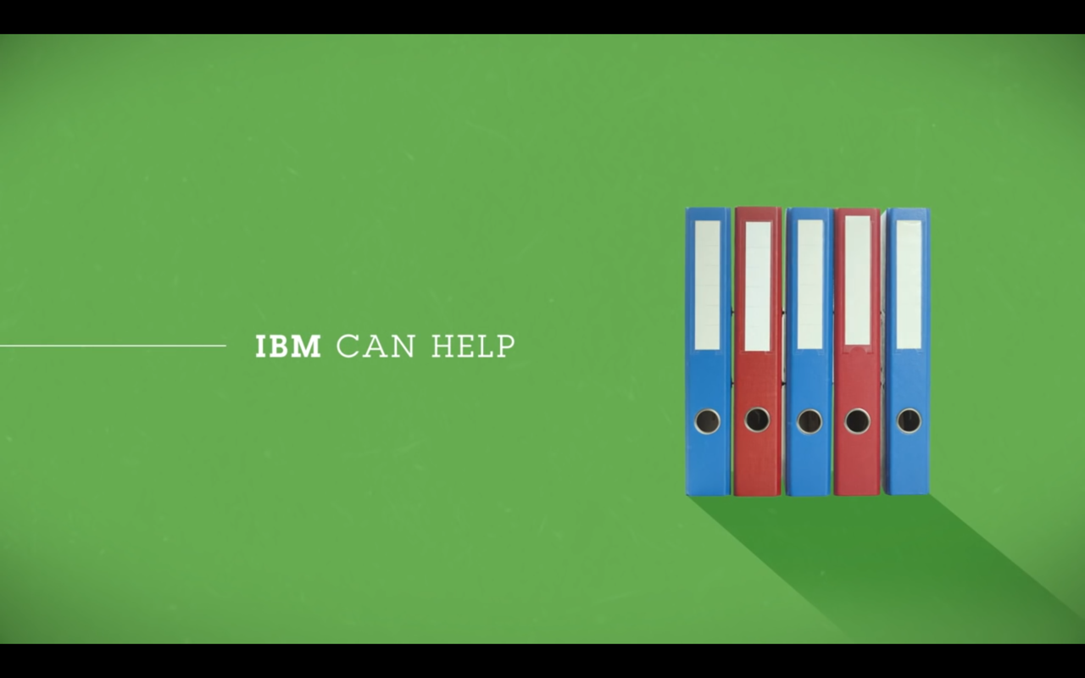


Slide 5
Why Choosing Informatica PowerCenter for data integration?
Raising the standard for enterprise data integration
Meet business demands with improved developer productivity:
Enhance business–IT collaboration
Real-time data for application and analytics
Highly scalable, always-on data integration:

Slide 6
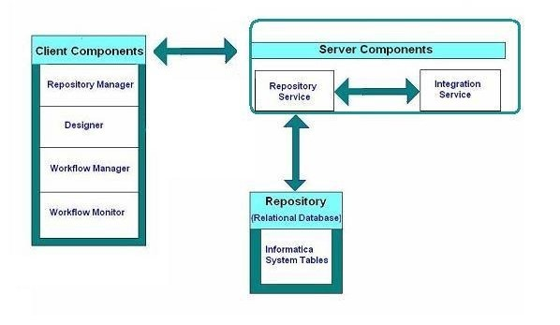
Components of PowerCenter

Slide 7


The Applications of PowerCenter

Slide 8
Thank You!

Slide 9
Informatica
Informatica is leading vendor in Enterprise Data Integration & Management Solutions
Enterprise Data Integration
Data Governance
Data Migration
Data Quality
Data Synchronization
Data Warehousing

Slide 10
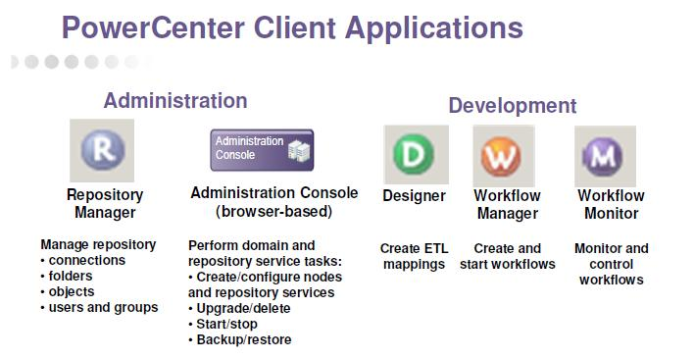
Enterprise Data Integration

Slide 11
Business Challenges
Performance
Quality
Handling All Business Requirements
Maintenance and Configurations
Versioning and Source Control
Security
Cost of Servers
Resources and Support

Slide 12
Performance
Features in Informatica
Deals With Partitioned Tables Efficiently.
Bulk Extract\Load
Option Disable Triggers
Generate IDs
Caching Techniquies
Parallel Processing

Slide 13
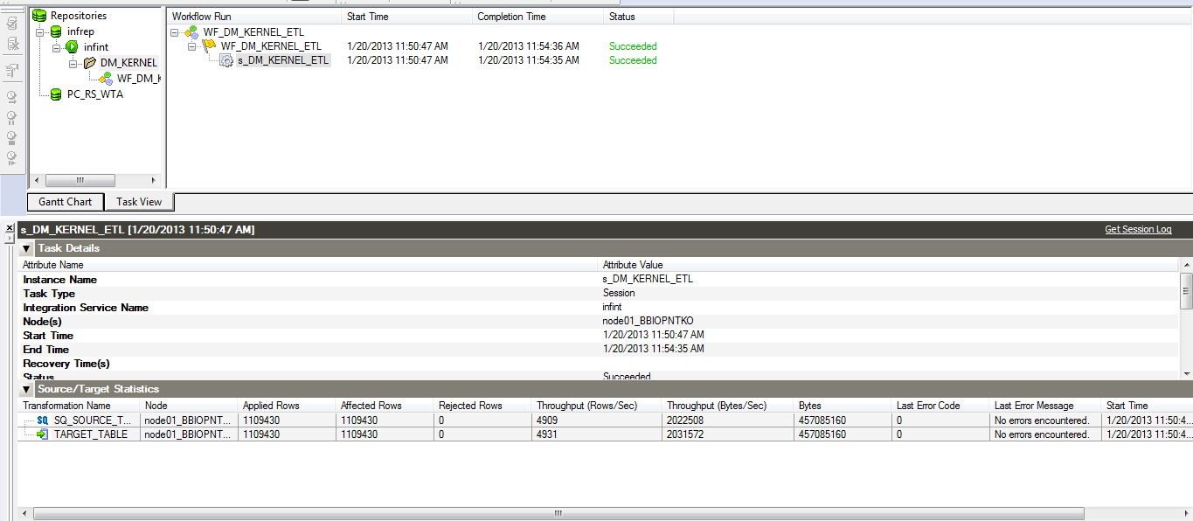
Performance
Case Study
Loading of +1,000,000 records in less than 4 minutes

Slide 14


Performance
Case Study
Revamping Nadjma Integration Solution from SAP Data Services which takes more than 15 hours to Informatica PowerCenter it takes now 4 hours with average load of 21,000,000 records.

Slide 15
Quality
Data Quality assures data is
Completeness: Data not missing or unusable
Conformity: Data is stored in a standard format
Consistency: Data values don’t give conflicting information
Accuracy: Data is incorrect or out of date
Duplicates: Data records aren’t repeated
Integrity: Data isn’t referenced

Slide 16

Quality
Case Study
DWH revamp resulted in need for developing reporting/universes using business Objects XI on top of Teradata
Upgrade of BI from Oracle to New Enterprise DWH based on Teradata
Review of Current Business Objects Environment
Re-design of ETL Methodology, Architecture and Techniques for Optimized Performance

Slide 17
Handling All Business Requirements
Transformation is a repository object that generates (SQL Source Qualifier, Lookup, Sequence Generator, Aggregator, Rank, etc..), modifies (Filter, Sorter, Expression, etc..), or passes (Update Strategy, Joiner, etc..) data
With the huge different-functionalities of Informatica transformations, it can handle all business requirements avoiding heading of the need to develop custom transformation.

Slide 18
Maintenance and Configurations
ICS feature for configuration
Separation of developing mappings and running workflows

Slide 19
Maintenance and Configurations
Case Study
Nadjma required to not using any static code, even parameters and although the project has +300 mappings, it hasn’t single line of static code, everything is configurable thanks to ICS feature.

Slide 20
Versioning and Source Control
Folders and Check-in and Check-out
Developers can control the changes over source code and can retain the multiple copies of source code and can give them a label (name).
Informatica PowerCenter Version Control tracks the code changes.
Informatica PowerCenter Version Control retains the accountability for a source code change. In simple words you can identify that which developer has done what.

Slide 21

Versioning and Source Control
Case Study
Vodafone: required to handle every month with change in business logic and retains other months with its logic separately
Nadjma: +5 developers working in same mappings with the advantage on Informatica PowerCenter Versioning and Source Control feature it allows
Secure source code
Returns to specific version in case of light changing requirements.

Slide 22
Security
Gives advantage to administrators to control who can do what.
Tracks every change happens.
With the ability to integrate with Informatica other products like Data Warehouse Advisor, you can monitor Workflows data consumption and loadtime.

Slide 23
Cost of Servers
Informatica PowerCenter with all these features can be installed on decent servers in terms of Specs and Cost.
All you need to install PowerCenter Server/Client a machine with Dual Core 2 GHz, 4 GB of Ram and HDD with 10 GB available space.

Slide 24
Cost of Servers
Case Study
Loading of +1,000,000 records in less than 4 minutes in machine with 6 GB of Ram and Core i3 processor 2.53 GHz

Slide 25
Resources and Support
Great support to whom developing and administering Informatica products Server\Client applications.
My Support subsite from Informatica provides valuable benefits free to all customers and partners like
Knowledge Base and Product Documentation
My Support Community
Velocity : a proven solutions methodology
How-to Library (H2L)

Slide 26
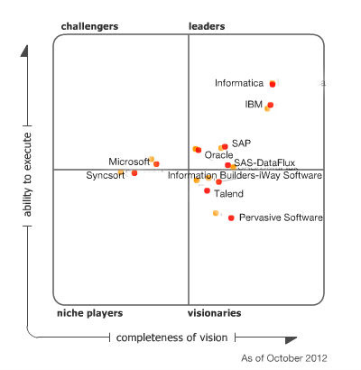
Benchmark of ETL Tools
Informatica Positioned in Leaders Quadrant in 2012
Magic Quadrant for Data
Integration Tools Report based
on “Ability to Execute” and
“Completeness of Vision”
by Gartner

